Slide 1
Agentic AI Hackathon: Building Intelligent Agents with IBM Granite and LangFlow

Slide 2



Name of the team: Alpha
Details of Team members
TEAM MEMBER NAME | Recent Passport Photo | Email ID | Phone number [WhatsApp]
MONISHA SRINIVAS |  | monishasrinivas3@gmail.com | 7019920243
MANUSHREE S |  | manumanusree51@gmail.com | 9632484251
SANJANA BG |  | bgsanjana1@gmail.com | 8105877484

Slide 3
Problem statement
Intelligent Agentic System for Traffic Flow Pattern Analysis
The Challenge
Intelligent agentic systems for traffic flow pattern analysis face significant challenges related to:
Data Quality and Availability: Agentic systems require continuous streams of high-quality, real-time data from various sources like sensors and cameras.
Integration with Legacy Systems: Many existing traffic management systems use older infrastructure not designed for advanced AI.
Coordination Complexity: In multi-agent systems, ensuring agents coordinate effectively and work toward a unified goal is difficult.
Security and Privacy Risks: Agentic systems collect vast amounts of data, including location information from GPS and surveillance footage
Real-Time Processing: Traffic conditions are dynamic and influenced by unpredictable factors like accidents or sudden weather changes.

Slide 4
Proposed solution
The proposed solution introduces an Intelligent Agentic System designed to autonomously analyze, interpret, and predict traffic flow patterns using artificial intelligence and agent-based reasoning.
The system addresses the limitations of traditional traffic management approaches by enabling real-time, adaptive, and explainable traffic analysis.
The architecture of the proposed system consists of a layered, modular framework that integrates data acquisition, intelligent agent reasoning, and AI-driven analytics to support effective traffic management and decision-making.
The core of the proposed solution is an intelligent agentic layer, where domain-specific agents are defined with explicit roles and objectives. These agents are responsible for analyzing traffic patterns, identifying congestion levels, detecting peak hours, and recognizing anomalous traffic conditions. Each agent operates autonomously while collaborating with other agents through structured prompts and shared context, enabling coordinated and scalable reasoning.
The proposed solution supports real-time analysis, predictive insights, and extensibility, allowing future integration with smart traffic signals, and connected vehicle infrastructures

Slide 5
Need of project
Rapid urbanization and the exponential growth of vehicular traffic have significantly increased the complexity of traffic management in modern cities. Conventional traffic management systems are largely static and rule-based, relying on predefined signal timings and manual supervision. Such systems are inadequate for handling dynamic and unpredictable traffic conditions caused by accidents, weather variations, public events, and fluctuating travel demand.
Modern traffic environments generate vast volumes of heterogeneous data from multiple sources, including road sensors, surveillance cameras, GPS-enabled vehicles, and mobile applications. Processing and interpreting this data in real time exceeds human cognitive capabilities and the limitations of traditional analytical methods. Intelligent agentic systems, equipped with autonomous reasoning and decision-making capabilities, are essential to effectively analyze complex traffic patterns and derive meaningful insights from continuously evolving data streams.

Slide 6
End user of project
An Intelligent Agentic System for Traffic Flow Pattern Analysis is designed to support a wide range of stakeholders involved in urban transportation planning, operation, and policy-making. The primary end users of the system are as follows.:
1. Traffic Management Authorities
Traffic control centers and municipal transportation departments are the principal end users of the system. These authorities utilize intelligent traffic analysis to monitor real-time traffic conditions, identify congestion hotspots, optimize signal timings, and coordinate incident response. The system supports data-driven operational decision-making and enhances overall traffic network efficiency.
2. Urban Planners and Policy Makers
Urban planners and government policymakers use the system to analyze long-term traffic patterns, assess infrastructure performance, and evaluate the impact of transportation policies. Predictive and simulation capabilities enable informed planning of road expansions, public transport systems, and smart city initiatives.
3. Smart City Administrators
Smart city authorities integrate the system within broader urban digital platforms to achieve sustainable and intelligent transportation management. The agentic system contributes to coordinated city-wide operations by enabling interoperability with other smart infrastructure components.

Slide 7
Technology Used
Langflow platform
Langflow component name – Agent , Chat input , Chat output
IBM Grainte model - for eg – ibm-granite-3-2-8b
IBM Cloud
IBM Watsonx.ai
Watsonx

Slide 8
Novelty and Uniqueness
· First platform merging micro‑climate sensing, GenAI, and policy
retrieval for urban adaptation.
· Uses non‑wearable, rooftop nodes—cheaper and easier to deploy
city‑wide.
· Granite‑guarded outputs ensure bias‑free, regulation‑compliant
advice.

Slide 9
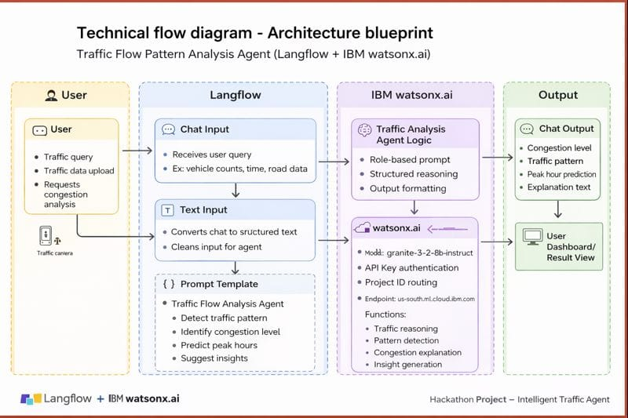
Technical flow diagram - Architecture blueprint

Slide 10
Langflow component Used
Explain the use of each langflow component used into you project
1)Chat Input – Text input and prompt template., IBM Watsonx.ai
2) IBM Watsonx AI Agent
File component
Chat output

Slide 11
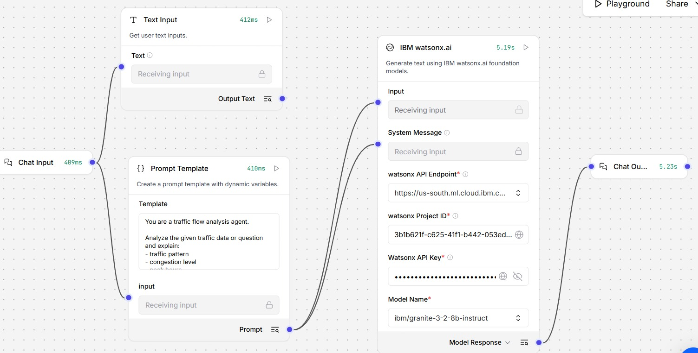
Input Screenshot

Slide 12
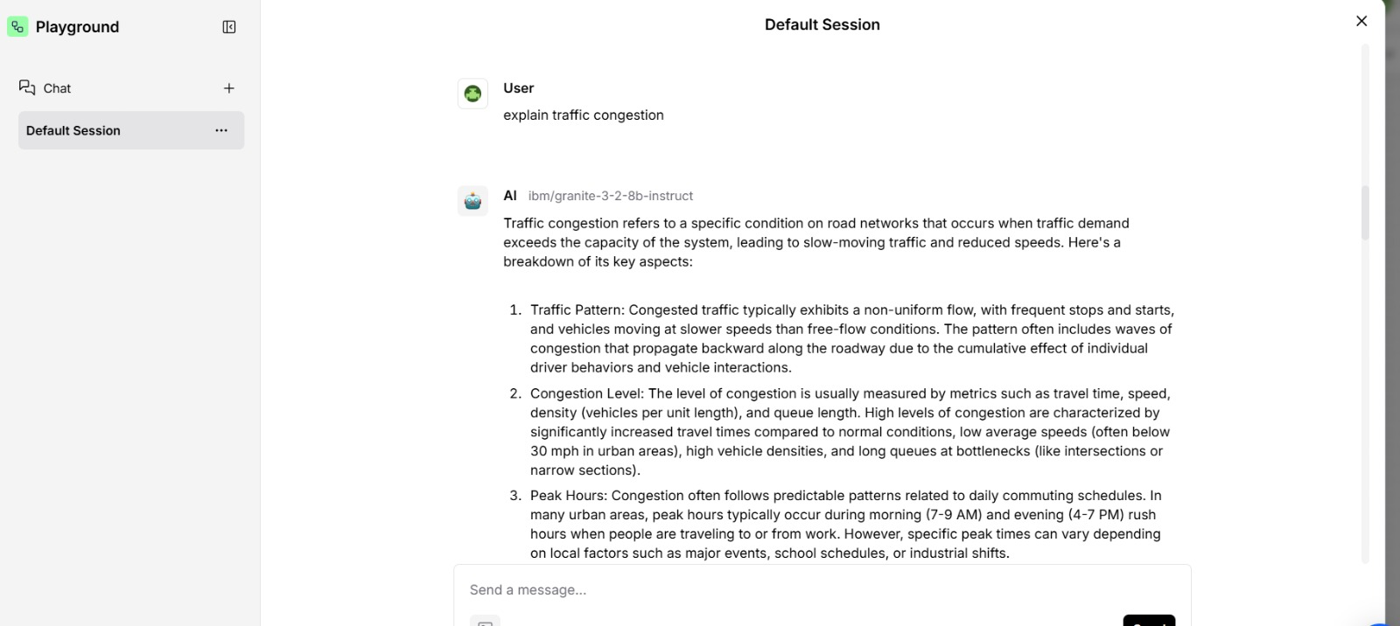
Output Screenshot 1

Slide 13
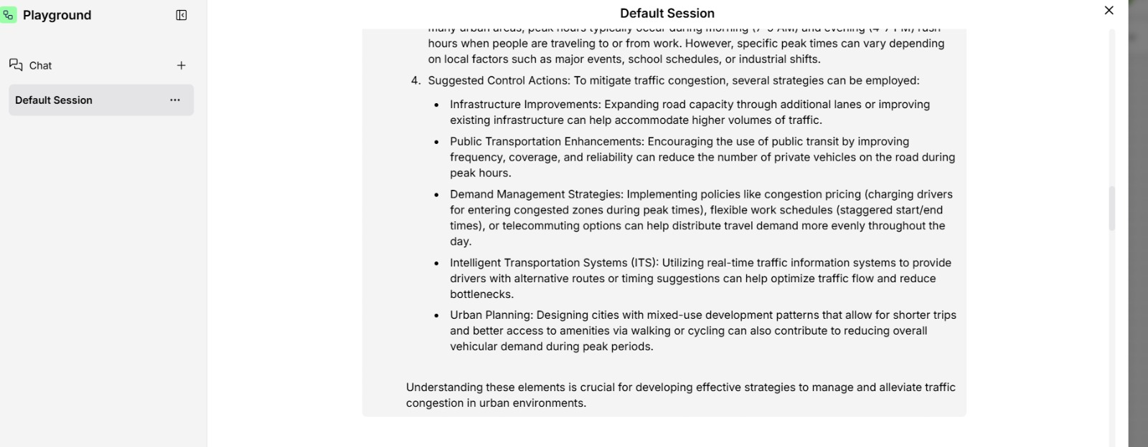
Output Screenshot 1
Output Screenshot 1

Slide 14
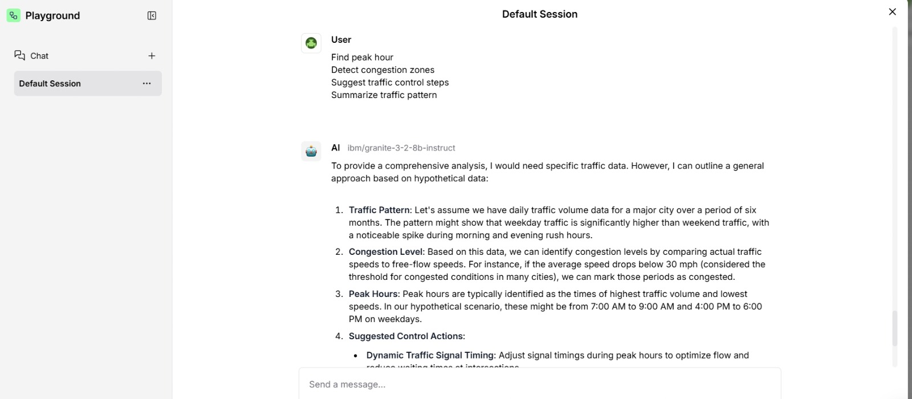
Output Screenshot 2

Slide 15
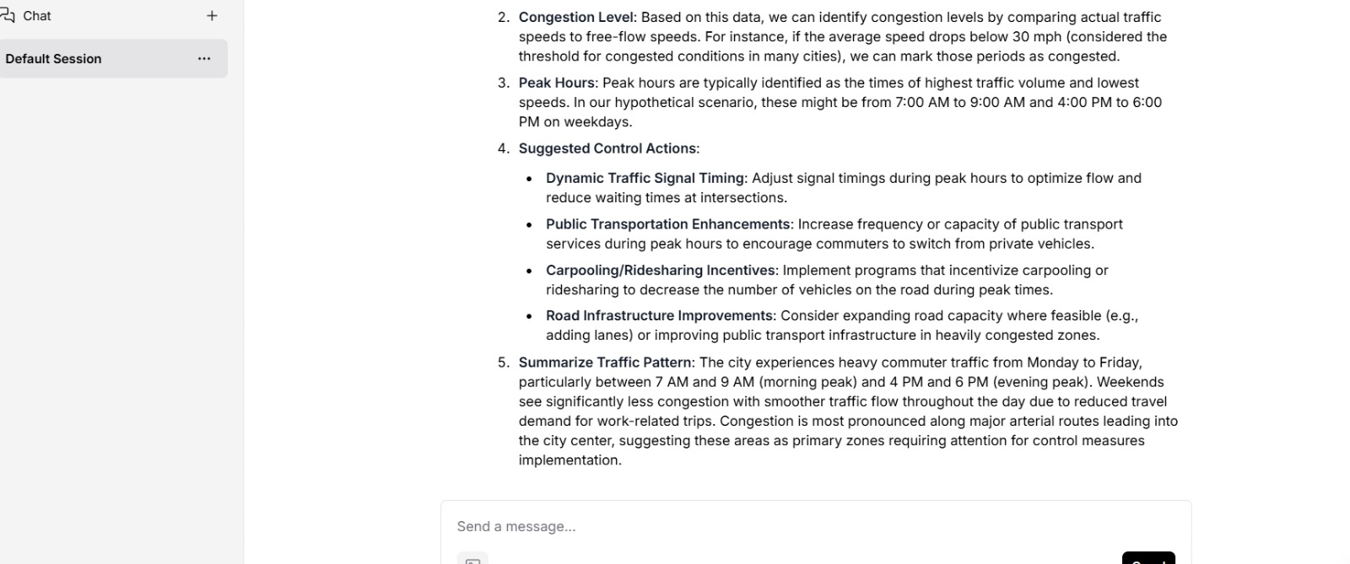
Output Screenshot 2

Slide 16
Future Scope
1. Real-Time Traffic Data Integration
Integrate live data streams from:
  IoT traffic sensors
  CCTV and video analytics systems
  GPS data from vehicles and mobile devices
Enable real-time congestion detection and alerts
Support stream processing frameworks (Kafka, MQTT, Apache Flink)
Impact: Faster response to traffic incidents and dynamic traffic control
2.Computer Vision–Driven Traffic Analysis
Integrate AI-based video analytics to:
  Count vehicles
  Classify vehicle types
  Detect illegal parking and lane violations
Fuse visual insights with textual agent reasoning
Impact: Richer situational awareness and higher accuracy.
3.Adaptive Traffic Signal Control
Enable closed-loop integration with:
  Smart traffic lights
  Variable message signs
Impact: Reduced congestion, fuel consumption, and emissions.
·
·
·

Slide 17
Git Hub Link
https://github.com/Monisha569/traffic-agent

Slide 18
References
Technology used
​IBM Granite 3.0 Model Family: Official documentation for enterprise-grade LLMs and reasoning capabilities. ibm.com/granite
​LangFlow Orchestration: Low-code platform for building multi-agent AI workflows. docs.langflow.org
​IBM WatsonX.ai: Enterprise studio for AI builders to train, validate, and deploy models. ibm.com/watsonx
​Domain Research (Traffic Analysis)
​Intelligent Traffic Management: Research on reducing CO2 emissions and fuel consumption via predictive flow analysis. (Source: NIH/PMC12552707)
​Agentic AI in Transportation: Exploring the transition from static traffic signals to dynamic, autonomous reasoning agents. (Source: IEEE Xplore / MDPI)
​Open Source
​LangChain Components: Standard library for enhancing LLM utility with context-aware tools.

Slide 19


